Slide 1
Westview Science Olympiad 2021-2022

Slide 2
Hello!
Meet the student board:
Aakarsh Vermani - President
Charles Zhang- VP of Operations
Sattwik Chakraborty - VP of Events
Ayush Nayak - Secretary
Ananya Bharathwaj - Treasurer
Meet our head coach:
Kathy Duston

Slide 3
What is Science Olympiad?
1

Slide 4
Teamwork is a required skill in most scientific careers today, and Science Olympiad encourages group learning by designing events that forge alliances.

Slide 5
Science Olympiad is:
Non-profit organization
Largest national science competition
Competitions are held at the Regional, State, and National levels

Slide 6
23 events
6 teams/school
15 students/team

Slide 7
WVSO Records
Year
2013
2014
2015
2016
2017
2018
2019
2020
2021
Place
2nd Regionals
1st Regionals
2nd Regionals
3rd Regionals
6th State
3rd Regionals
6th State
4th Regionals
4th Regionals
6th State
1st Regionals
States Cancelled
2nd Regionals

Slide 8
Practices
Events usually meet once a week for 1-2 hours online or in-person
Practices with entire team (~8-12 students)
Competition with 1-2 partners
A LEVEL II CLEARED adult must be present at all school practices!
On-campus meetings only allowed under teacher/staff supervision

Slide 9
Coaches
Students and parents can coach
1-2 coaches per event
Can be experienced or learn with the team
Student Must submit COACH APPLICATION via Google Form (submit by TBD)
Provide a tentative schedule and curriculum
Be prepared to communicate with students and the board
*Coaches still needed for several build events*

Slide 10
Students
MUST ATTEND practices or notify coach of absence
Must Self-report absences in the online portal
Work with your partner(s)
You are not allowed to have more than 3 unexcused absences
Attend event day

Slide 11
Code of ethics
Parent’s Pledge
On behalf of the parents and spectators, I pledge to be an example for our children by:
respecting the rules of Science Olympiad,
encouraging excellence in preparation and investigation,
supporting independence in design and production of all competition devices,
and respecting the decisions of event supervisors and judges.
Our examples will promote the spirit of cooperation within and among all of our participating teams.
Student’s Pledge
I pledge to put forth my best effort in the Science Olympiad principles of honest competition. In my events, I will compete with integrity, respect, and sportsmanship toward my fellow competitors. I will display courtesy toward Even Supervisors and Tournament Personnel. My actions exemplify the proud spirit of my school, team, and state.

Slide 12
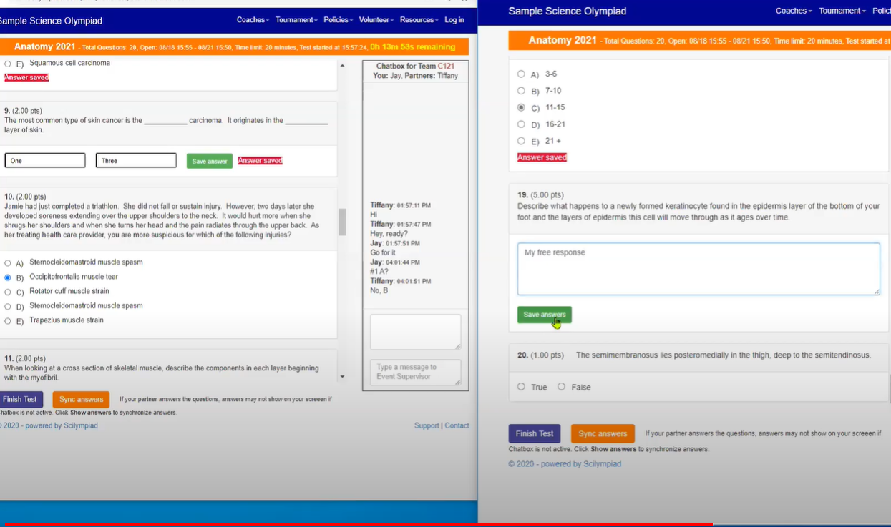
Competition Format: MiniSO or In Person or Hybrid
“Tests can still be prepared by Event Supervisors and delivered through a variety of tech platforms, via email, or even snail mail if needed.”
All teams will compete in their events virtually with their partner(s) with a live chat built into the Scilympiad website
Events will be proctored by coaches, teachers, parents, etc.
February 2022
In Person competition:
Tests written by Event Supervisors and given in person
March 2022
Hybrid competition:
Study and build separated

Slide 13
Events
2
Pandemic Style

Slide 14
Events - Link in Chat.
The format of many events is dependent on whether the competition will be online or in person. For example, many lab and build events have been changed to study events.
If anyone has experience with these events or is willing to learn, you should coach!
You can get community service hours!
If anyone is interested in helping out Science Olympiad - even if you can’t coach, we would appreciate it! All event meetings require a Level II adult, so if you have clearance then please let us know.
*Depending on the format of the Regional Competition, the event rules might change...
Notes:
Literally if you can just sign on to zoom, and leave it there, we would appreciate that. Might be slightly different for

Slide 15
Events By Category
*These might not be finalized yet.
Study Event
Build Event
Lab Event
Bolded - New Event
Life, Personal, and Social Science
Anatomy & Physiology (Nervous, Endocrine, Sense Organs)
Cell Biology NEW!
Disease Detectives
Ornithology (study of birds)
Green Generation NEW!
Earth and Space Science
Astronomy
Dynamic Planet
Remote Sensing NEW!
Rocks and Minerals NEW!
Notes:
Mention coach and ask for anyone to raise hand + write down name if they’re interested in coaching a coach-less event
Green = study
Blue = build
Red = lab
Bold = new
$ = requires material costs

Slide 16
Events By Category cont’d...
*These might not be finalized yet.
Study Event
Build Event
Lab Event
Bolded - New Event
Physical Science and Chemistry
Physics
WiFi Lab NEW!
It’s About Time NEW!
Trajectory NEW!
Chemistry/Biochemistry
Chem Lab
Forensics
Environmental Chemistry NEW!
Notes:
Mention coach and ask for anyone to raise hand + write down name if they’re interested in coaching a coach-less event
Green = study
Blue = build
Red = lab
Bold = new
$ = requires material costs

Slide 17
Events By Category cont’d...
*These might not be finalized yet.
Study Event
Build Event
Lab Event
Bolded - New Event
Technology and Engineering
Detector Building
Gravity Vehicle
Bridge NEW!
Wright Stuff NEW!
Inquiry and Nature of Science
Codebusters
Experiment and Data Analysis
Ping Pong Parachute NEW!
Write it Do it
Notes:
Mention coach and ask for anyone to raise hand + write down name if they’re interested in coaching a coach-less event
Green = study
Blue = build
Red = Lab
Bold = new
$ = requires material costs

Slide 18
Reimbursements!
Coaches and volunteers
Don’t hesitate to spend for your build/lab event — we will reimburse you!
If purchasing over $100, please email us first
Keep a physical and scanned copy of receipt
Send receipt to us (westviewso.ss@gmail.com) right after the purchase to receive quick reimbursements!
More info at coach meeting
Notes:
Just a brief reminder, we’ll talk more at coach meeting

Slide 19
Registration
3

Slide 20
Registration Process
Create an Account Online
Complete Online Registration
Complete Online Student and Parent Consent
Payment
$60 per student
+ $10 for shirt
*Will likely open up next week, but waiting for confirmation
Notes:
After registration opens, it will be due two weeks following that.

Slide 21
Who Needs To Register?
ALL Students!
Team members
Student coaches
ALL Coaches!
Parent coaches
Student coaches
Parents:
Volunteers
Those who want to be on the email list
*ALL students must have a parent register
Notes:
Students need a parent to register since the registration process includes an agreement to terms of participation.
All parents can start off by signing up as a parent, and it can be later switched to adult coach.

Slide 22
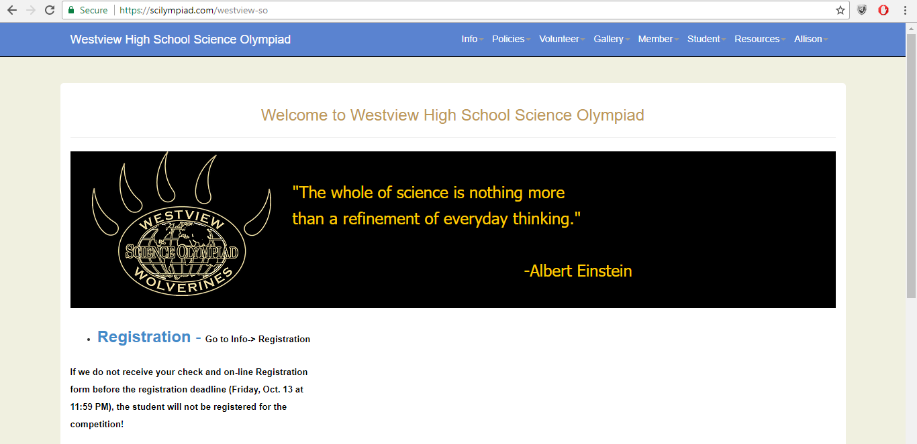
STEP 1
Place your screenshot here

Slide 23
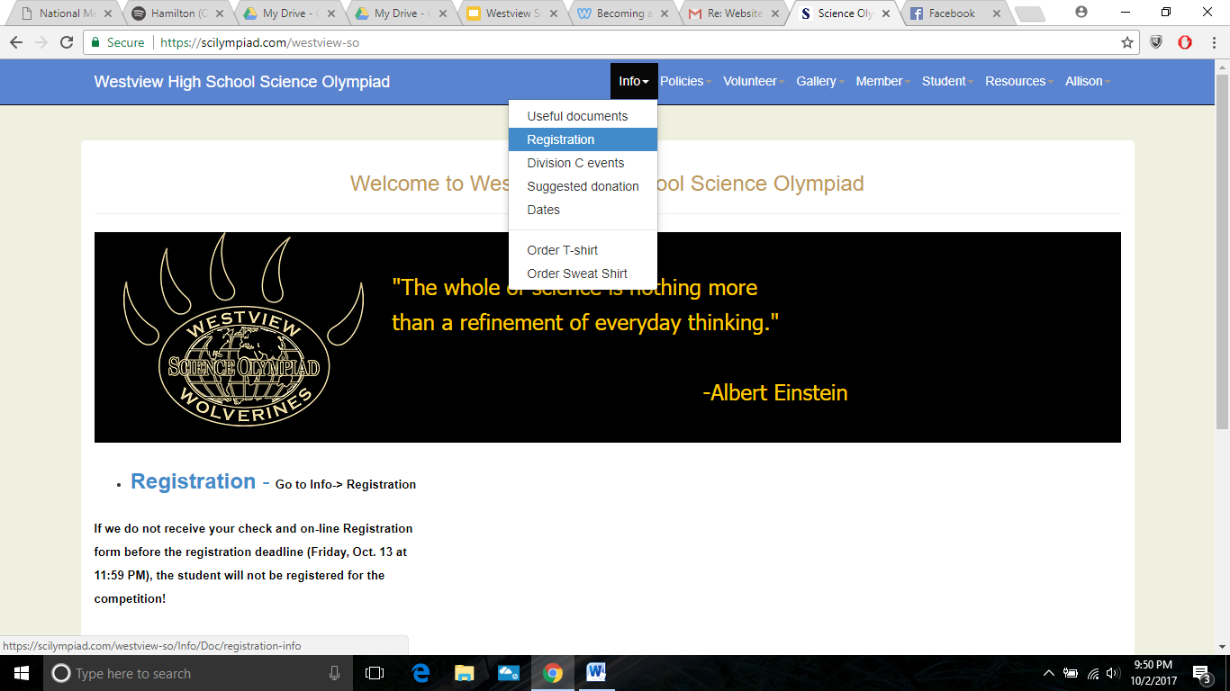
STEP 2
Place your screenshot here

Slide 24
STEP 3
Place your screenshot here

Slide 25
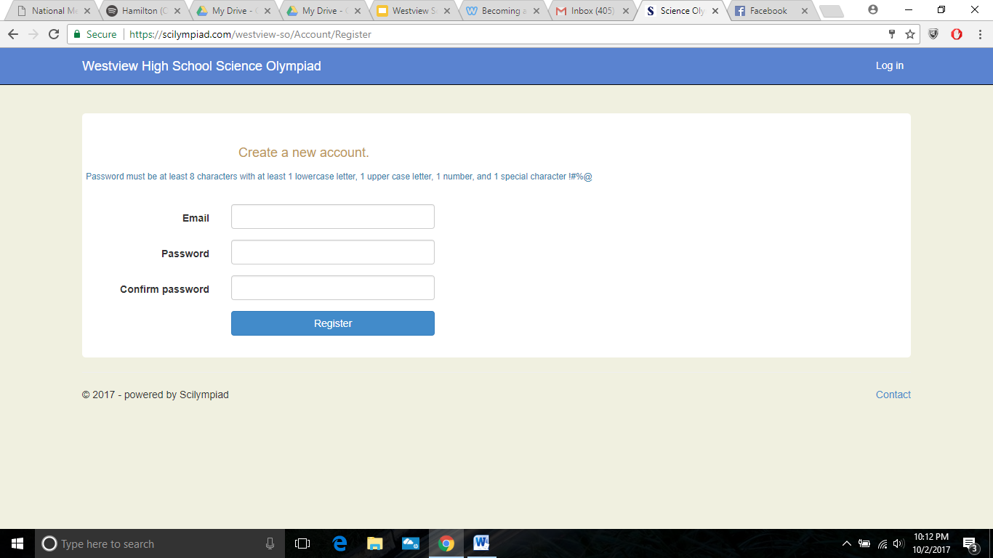
STEP 4
Place your screenshot here

Slide 26
Tentative Dates
(Pay attention to email for official dates)
Online Registration Opens:
Early next week
Finish Online Registration by:
2 weeks after registration opens
Student Coach Application Due:
Same day as registration
Teams announced:
3 days after registration ends
Start practices by:
Early October
Meeting Audits:
October through March
Tentative Invitational(s)
Golden Gate (Date TBD)
Regional Competition Date:
Online: February 26, 2022
In Person: March (TBD), 2022
State Competition:
April 2, 2022 (Online)

Slide 27
Thanks!
Questions? Talk to us after the meeting!
Email our boards!
westviewso.ss@gmail.com
(student board)
westviewso@gmail.com
(parent board)
Westview Science Olympiad website
https://scilympiad.com/westview-so
Instagram
@westviewscioly
Notes:
Talk about facebook group

