Slide 1
Circuit Lab
B/C

Slide 2
Each team should bring
Three ring binder
2 calculators

Slide 3
The rules also state you can bring...
Multimeter -- at the discretion of the event supervisor (not sure this is a good idea?)

Slide 4
Written Test (50-75% of total score -- determined by event leader)
On the left I will put the very straight forward part of the rules
i.e. Metric units (unless others are requested)
On the right I will put the rules that might give a little more pause…. Or are just new to the event
(I would make sure they know the Gauss, even though the Tesla is the metric unit of magnetism)
They should be familiar with significant figures

Slide 5
Ten topics for both B and C level
i. Historical perspective (key people) (named in the rules)
ii. properties of electric charge/fields, Coulomb’s Law
iii. DC Characteristics, sources, uses, simple circuit diagrams
iv. AC characteristics, sources, uses,
v. concepts and units of: current, voltage, resistance, power, and energy. Ohm’s Law
ii. sources/hazards of static electricity, capacitance
iii. DC hazards
iv. hazards
v. [C level -- Is Ohm’s Law really a “Law” -- does it always hold? When does it not?]

Slide 6
Ten topics (con’t)
vi. magnetic poles/fields, electromagnets, transformers, motors/generators
viii. simple calculations (use to say measurements), construction, and configurations of a circuit and individual components
x. simple circuit analysis using Kirchhoff’s rules
vi. right hand rule [IMO: B level: what is the directions of the magnetic field due to current carrying wire - C level would also include what is the direction of force on a charge moving in a magnetic field]
vii. electrical control devices including a 3 way light switch circuit (possibly also relays and mercury switches)
ix. characteristics and operation of a LED

Slide 7
Last 5 topics are C level only
xi. basic digital logic and digital logic operations
xii. Basic electrical characteristics of a silicon PN junction
xiv. Basics and applications of operational amplifiers (OpAmps)

Slide 8
What is not here
Per the rules….
Topics not included in the competition are: semiconductors (beyond those listed above), AC circuit theory, inductance, calculations involving direct use of calculus and/or differential equations, non-linear devices, three-state logic gates, sequential logic, 3 Phase Power, and oscilloscopes
? They removed the time constant calculations, but Capacitors are still a topic, so time constants are debatable…. But they do say so differential equation, so I would cover time constants for your C top team if they are going on to state

Slide 9
Hands on Tasks (25-50%)
Must have at least one
Should be familiar with the operation of breadboards

Slide 10
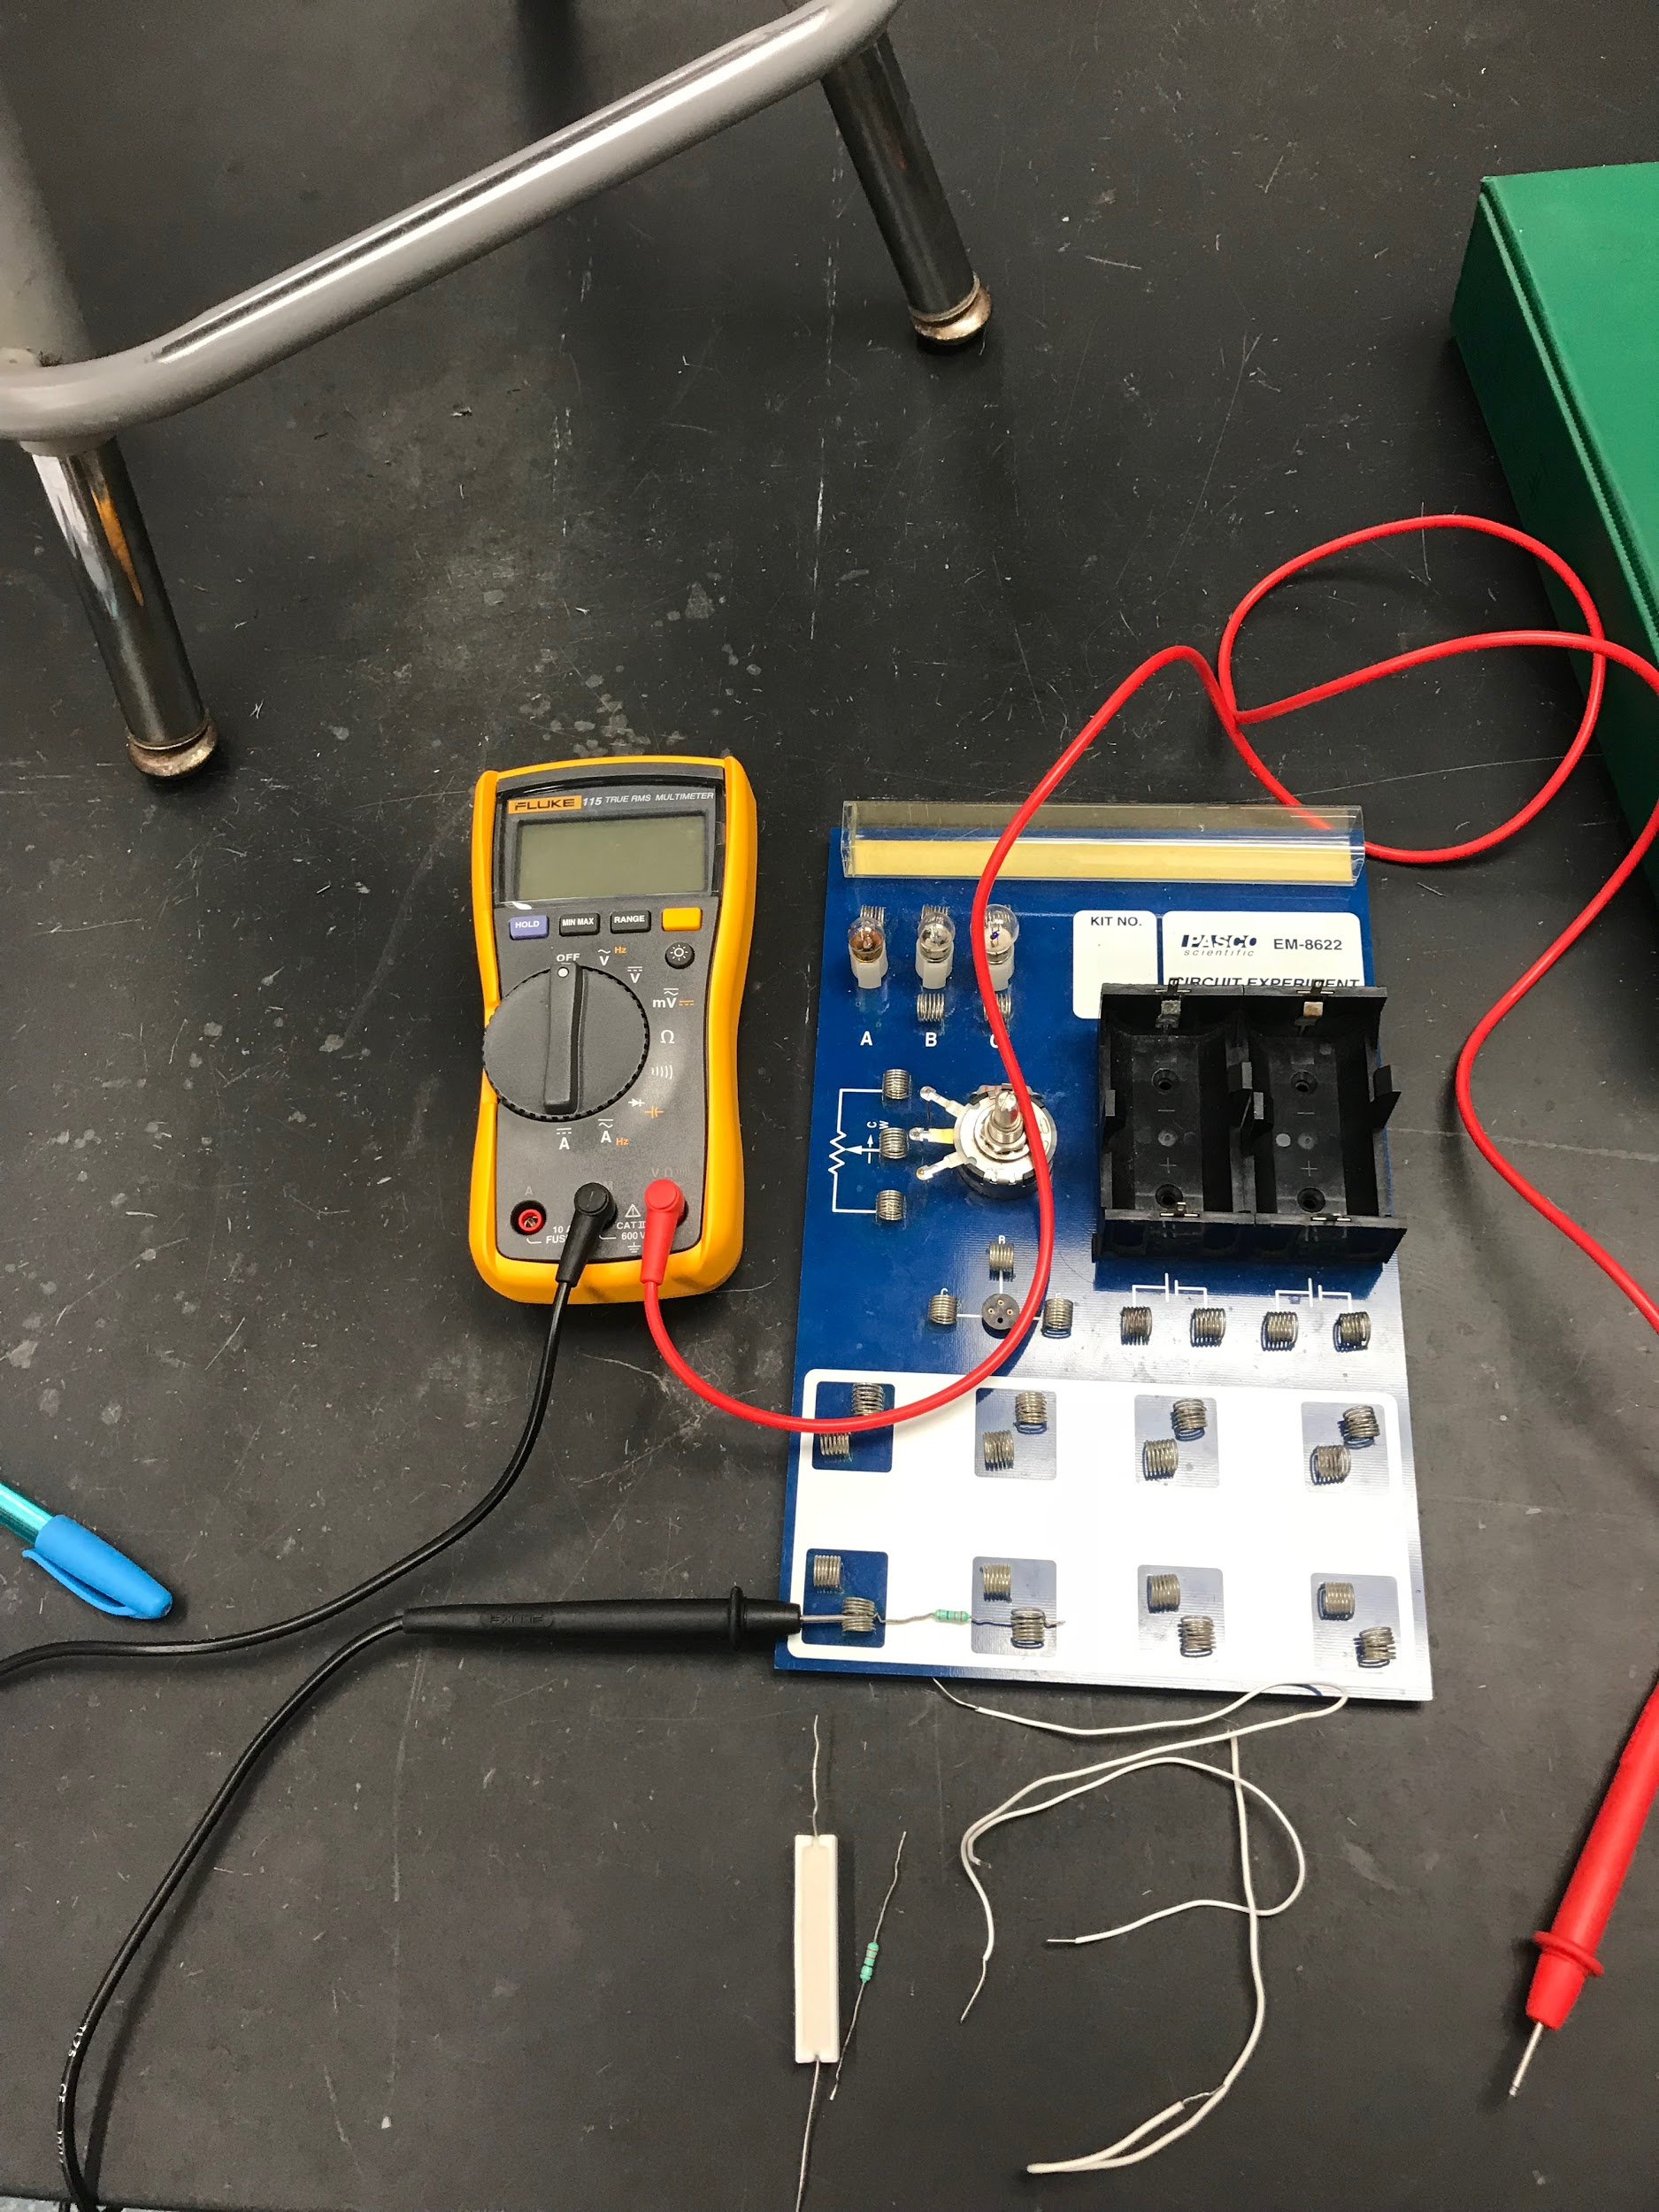
Example:
For this question, you may not use your own multimeter. Look at the resistor already on the circuit board, it has the colors: orange, orange, brown, gold
What is the resistance of the resistor as determined by the color coding?
Without changing the arrangement of what is already on the circuit board, place the two resistors on the table in parallel with each other and in series with the one already on the board. Note how the ends of the resistors do not need to be bent -- DO NOT BEND THE RESISTOR WIRES. You may use the additional wires and bend these as needed. Make a circuit diagram of your arrangement including the meter

Slide 11
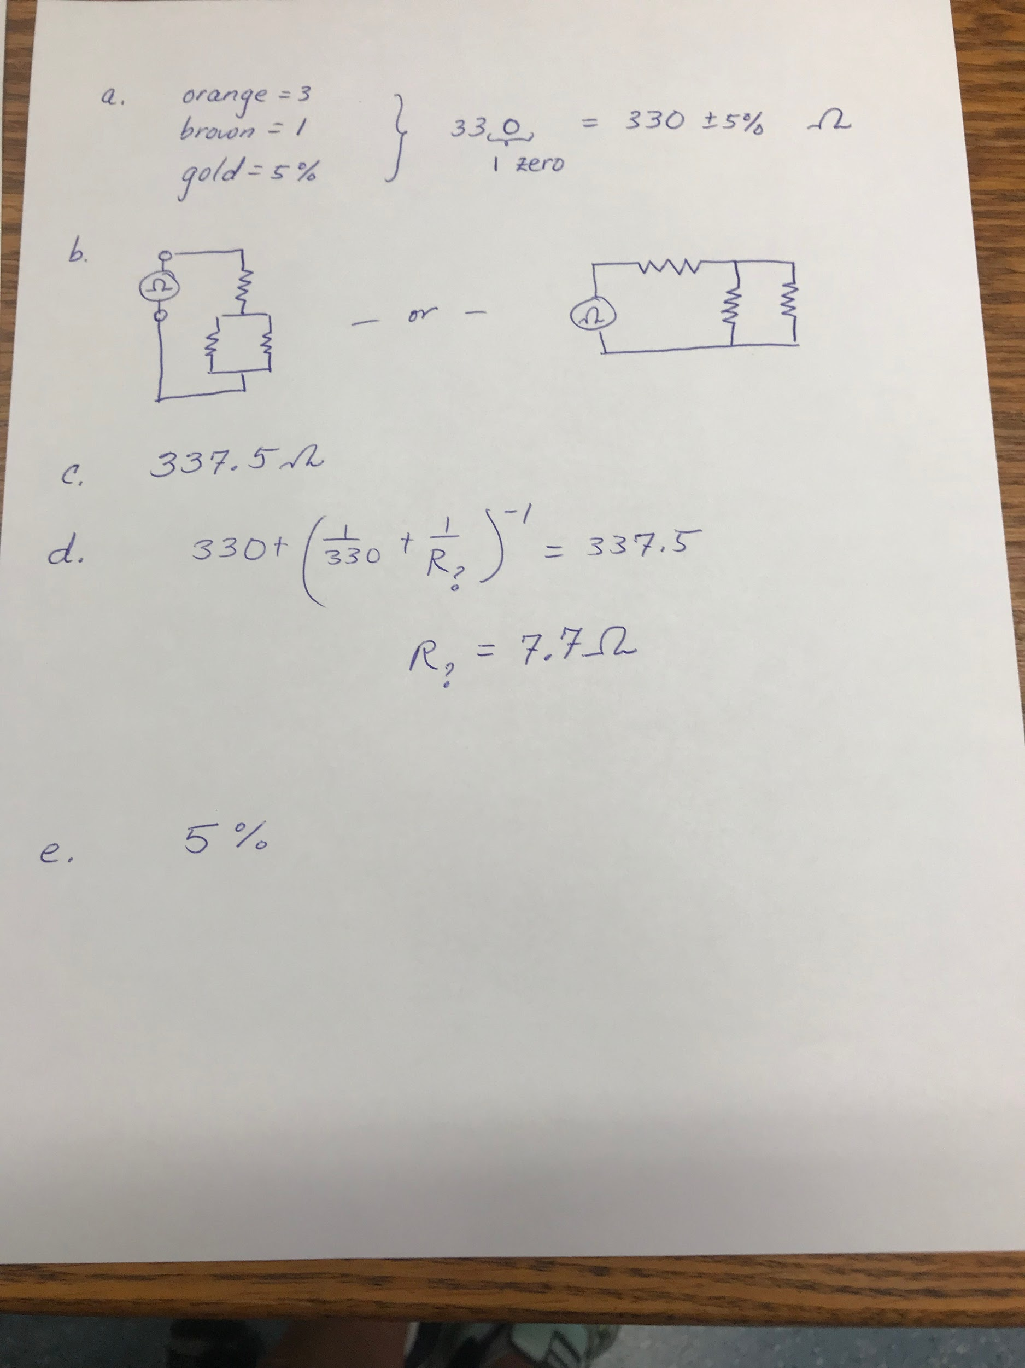
Example (con’t)
C. Measure the total resistance of your wired circuit.
D. Knowing the total resistance, calculate the resistance of the unknown resistor -- Show your work.
E. How much error (by percent) could be introduced due to the resistors?

Slide 12
Non- equipment station example [C only?]
Here is student data from their Ohm’s Law lab:
Resistance in Ohms Current in mA
10 147
330 4.45
100 14.8
47 31.3
On the graph paper provided
Manipulate the data so that a graph would be linear and from it you can determine the voltage of the battery from your graph’s slope

Slide 13
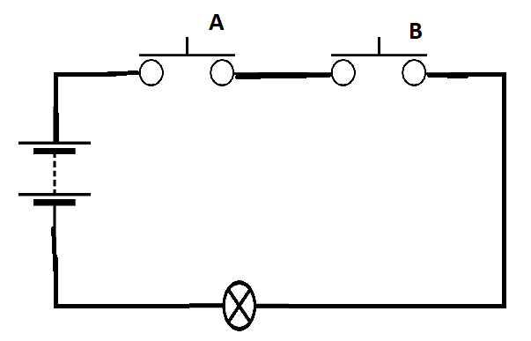
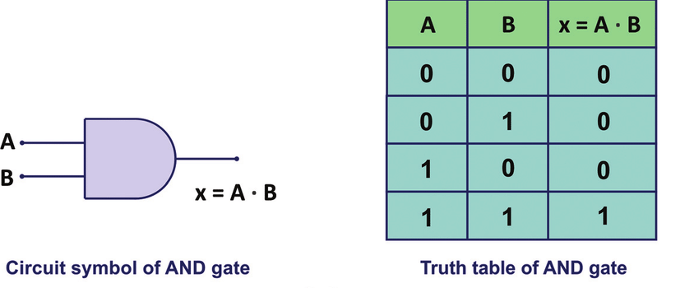
You have 2 “push to make” switches, a battery, wire and a light (C only)
You can make a truth table and see that this demonstrates AND
How can you wire this so that it is an “AND gate” -- that is when the buttons are on = true, and when the buttons are not pushed = off = false. The light bulb should light when the result is true
Explain why this does demonstrate the logic of “AND”
What is the circuit symbol for AND

Slide 14
My Thoughts, Opinions and Reflections
Last time this was done as an event, it was 50/50 -- half the group worked on stations while the other half took the written portion, then they switched after 25 mins.
I would have students familiar with decoding resistors -- and make sure they are both not color-blind
RB gave their top team a multimeter, but no other team -- they didn’t need it.
I recall them saying the test was fair but hard
2015 -- not 2019

Slide 15
Capacitance and charge are usually really small quantities -- make sure your students are familiar with the prefixes (micro, nano, pico) -- electric field strength and voltage can be large (Mega and kilo)

Slide 16
Whoever is leading your event should buy extra fuses for their multimeters
The cheap ones from Harbor Freight are not very accurate, but are a good starting point -- you won’t care so much if the kids break them

Slide 17
Don’t ask me the logic of a middle school kid not needing to know how a PN junction works but knows how a LED does…

Slide 18
Questions for the event supervisor that I cannot answer…. -- and I asked last year and was not given an answer
What type/brand of multimeter will you be using? Is it self-scaling -- if it isn’t, what does your multimeter look like when it is off-scale [this one they should totally tell us]
What will be the percent break-down?
Will you provide a list of what you consider standard circuit component drawings? Last time this was an event, the leader did this. (2015, not 2019)

Slide 19
